Slide 1
R for Libraries
Session 3: Data Analysis & Visualization
Clarke Iakovakis
Scholarly Communications Librarian
University of Houston-Clear Lake
This work is licensed under a Creative Commons Attribution 4.0 International License.

Slide 2

About me
Scholarly Communications Librarian at the University of Houston-Clear Lake

Slide 3

Outline for Today
Cleaning up strings with stringr
Grouping & summarizing data with dplyr
Visualizing data with ggplot2

Slide 4
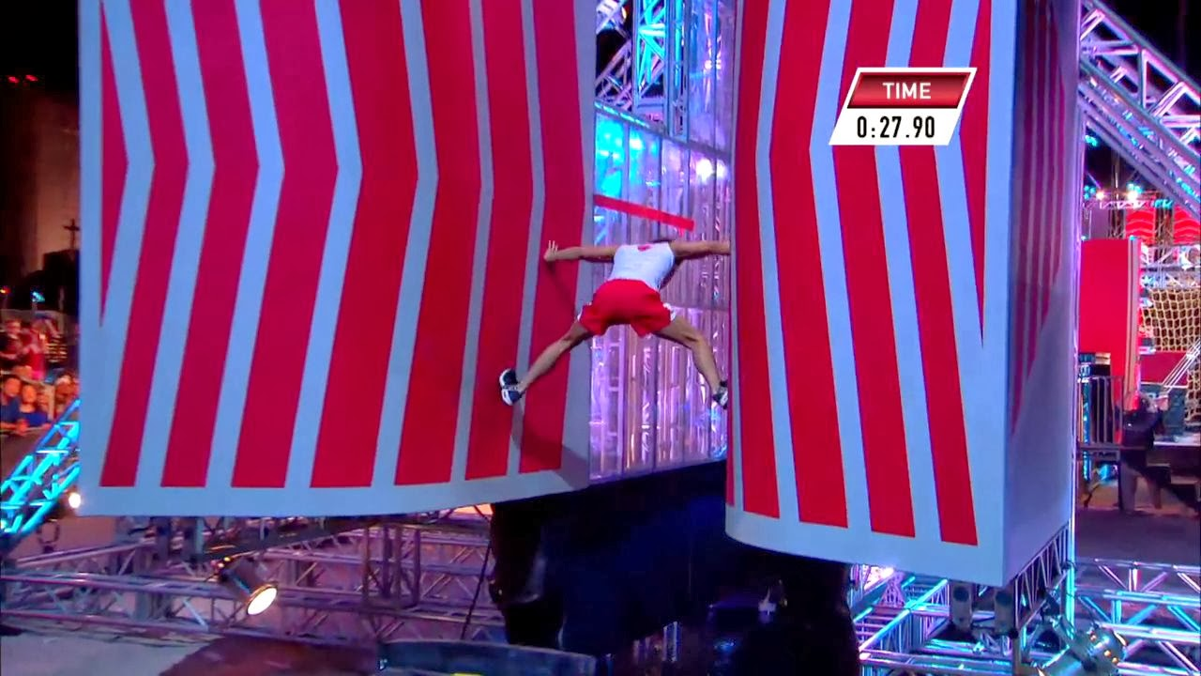
…Still overwhelming!
This session has a long handout with many examples.

Slide 5
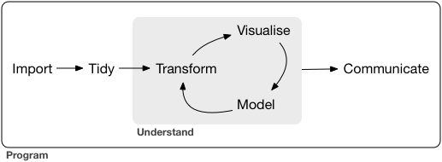
Cleaning strings & creating summaries

Slide 6
Load in ebooks data
Set your working directory
> setwd("C:/Users/iakovakis/Documents/ALCTS R Webinar")
Read in the data file
> ebooks <- read.csv("./ebooks.csv"
, stringsAsFactors = F
, colClasses = c("ISBN.Print" = "character"
, "ISBN.Electronic" = "character"))

Slide 7

stringr
The stringr package is essential for working with character strings.
It is included in the tidyverse installation
Library data contains lots of messy character strings, such as
Titles (journals, databases, books)
Subject headings
ISBNs/ISSNs (even though they are digits, they are treated as characters because they are identifiers)
> install.packages(“stringr")
> library(“stringr")

Slide 8
String problems
> mean(ebooks$User.Sessions)
[1] NA
Warning message:
In mean.default(ebooks$User.Sessions) :
argument is not numeric or logical: returning NA
Why can’t I get the mean user sessions?
> class(ebooks$User.Sessions)
[1] "character"
The vector class is not numeric or logical.

Slide 9
String problems
Why did R read this in as character?
> unique(ebooks$User.Sessions)
[1] "1" "2" "7" "3" "14" "15" "6" "8" "5" "12" "23" "4" "18" "42" "11" "9"
[17] "10" "29" "24" "16" "22" "34" "43" "56" "27" "146" "1,123" "123" "25" "31" "19" "13"
[33] "21" "46" "39" "285" "28" "697" "17" "240" "147" "49" "48" "109" "57" "20" "76" "30"
[49] "51" "53" "41" "26" "98" "44" "97" "115" "50" "33" "207" "61" "38" "81" "175" "134"
[65] "66" "155" "94" "99" "89" "331" "75" "182" "217" "82" "135" "52" "32" "213" "254" "36"
[81] "129" "37" "65"
THE COMMA!

Slide 10
String problems
In fact, the Total Pages, Pages Viewed, and Pages Printed are all read in as character due to the use of a comma in the thousands place.
> str(select(ebooks, Pages.Viewed:User.Sessions))
'data.frame': 10000 obs. of 4 variables:
$ Total.Pages : chr "434" "158" "226" "116" ...
$ Pages.Viewed : chr "11" "12" "1" "2" ...
$ Pages.Copied : int 0 0 0 0 0 0 0 0 0 0 ...
$ Pages.Printed: chr "0" "0" "0" "0" ...
$ User.Sessions: chr "1" "1" "1" "2" ...

Slide 11
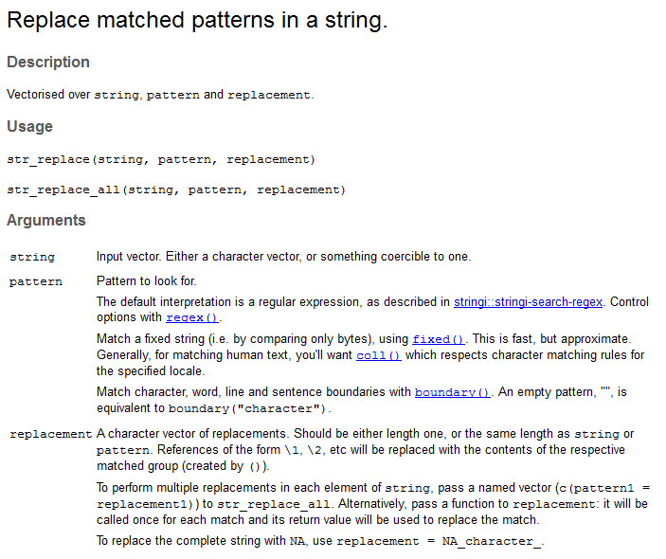
stringr::str_replace_all
str_replace() is similar to Find/Replace in Microsoft Excel
help(str_replace)

Slide 12
stringr::str_replace
> vec <- c("800", "900", "1,000")
> vec2 <- str_replace(vec
, pattern = ","
, replacement = "")
Arguments to str_replace():
string: The original vector (must be a vector, not a data frame)
pattern: The pattern to look for
replacement: What to replace it with (if nothing, an empty set of quotes ""

Slide 13
stringr::str_replace
We’ve remove the comma but still have a problem:
the vector is still characters, meaning you can’t do any mathematical operations with them
> class(vec2)
[1] "character"
You must use as.integer() to coerce it to integer values
> vec2 <- as.integer(vec2)
> vec2
[1] 800 900 1000

Slide 14
stringr::str_replace
On the ebooks data, we can use mutate() in combination with as.integer() and str_replace to replace commas in all the affected variables
ebooks <- mutate(ebooks
, Total.Pages = as.integer(str_replace(ebooks$Total.Pages, ",", ""))
, Pages.Viewed = as.integer(str_replace(ebooks$Pages.Viewed, ",", ""))
, Pages.Printed = as.integer(str_replace(ebooks$Pages.Printed, ",", ""))
, User.Sessions = as.integer(str_replace(ebooks$User.Sessions, ",", "")))

Slide 15
stringr::str_sub
str_sub(): takes a vector, a starting character, and an ending character, and grabs the characters in between those points
> ebooks$LC.Call[1]
[1] "ML3275.C86 1999eb“
> str_sub(ebooks$LC.Call[1]
, start = 1
, end = 1)
[1] "M"

Slide 16
stringr::str_sub
Use str_sub() in combination with mutate() on the LC.Call variable.
This will create a new variable LC.Class consisting of only the first character from LC.Call.
ebooks <- mutate(ebooks
, LC.Class = str_sub(LC.Call
, start = 1
, end = 1))

Slide 17
stringr::str_trim
str_trim(): removes whitespace from start and end of string
> vec3 <- c(" a", "b ", " c ")
> vec3
[1] " a" "b " " c "
> str_trim(vec3)
[1] "a" "b" "c"

Slide 18
stringr::str_detect
str_detect(): Detect the presence or absence of a pattern in a string.
> vec3 <- c(" a", "b ", " c ")
> vec3
[1] " a" "b " " c "
> str_trim(vec3)
[1] "a" "b" "c"

Slide 19

Grouping & summarizing data with dplyr
group_by(): Cluster the dataset together in the variables you specify
summarize(): Use on grouped data to get summary information

Slide 20
dplyr::group_by
group_by(): Cluster the dataset together in the variables you specify
> byLC <- group_by(ebooks, LC.Class)
On its own, it just creates a grouped data frame.
It should be used in conjunction with summarize() to get summary information by group

Slide 21
dplyr::summarize
summarize(): Use on grouped data to get summary information.
Not particularly helpful without group_by(), because it is only one group!
> summarize(ebooks, mean(User.Sessions))
mean(User.Sessions)
1 3.4309
> mean(ebooks$User.Sessions)
[1] 3.4309

Slide 22
dplyr::summarize
> UserSessions_byLC <- summarize(byLC, totalSessions = sum(User.Sessions))
This takes the grouped byLC dataframe and sums up the total number of User Sessions per call number.
It then returns that in the form of a data frame.

Slide 23
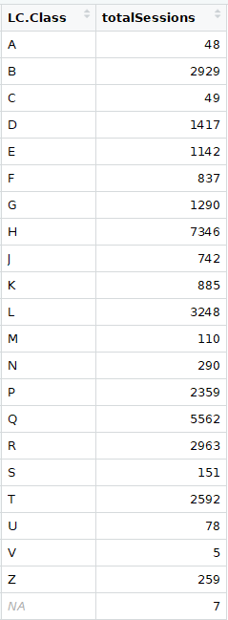
dplyr::summarize
View(UserSessions_byLC)

Slide 24
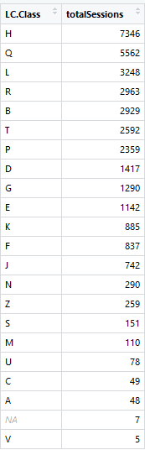
dplyr::summarize
View(arrange(UserSessions_byLC
, desc(totalSessions)))

Slide 25
The dplyr pipe %>%
The pipe %>% combines multiple dplyr operations
This helps so you don’t have to create several intermediate (junk) data frames like byLC and makes for easier to read code

Slide 26
summarize, group_by and %>%
> byLCSummary <- ebooks %>%
group_by(LC.Class) %>%
summarize(
count = n()
, totalSessions = sum(User.Sessions) , avgSessions = mean(User.Sessions)) %>%
arrange(desc(totalSessions))
Creating three new variables:
count: use n() to get the number of books per call number
totalSessions: sum of User Sessions per call number
avgSessions: average User Sessions per call number

Slide 27
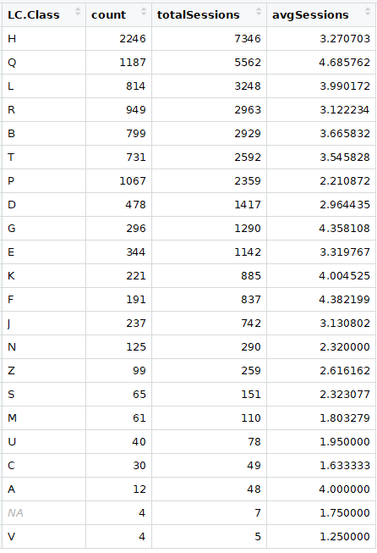
dplyr::summarize
View(byLCSummary)
H has the highest number of items and User Sessions
Q has the highest average sessions, which means that these items are getting more heavily used
(or at least some of them are)

Slide 28
Summary statistics
If you’re a statistics person, you have many other options:
median()
sd(): standard deviation
IQR(): interquartile range
min() and max()
quantile()
distinct_n(): number of unique values
var(): variance

Slide 29
Summary statistics
> byLCSummary <- ebooks %>%
group_by(LC.Class) %>%
summarize(
count = n()
, totalSessions = sum(User.Sessions)
, avgSessions = mean(User.Sessions)
, medianSessions = median(User.Sessions)
, sdSessions = sd(User.Sessions)
, highestSession = max(User.Sessions)
, lowestSession = min(User.Sessions)
, varianceSession = var(User.Sessions) %>%
arrange(desc(sdSessions))

Slide 30
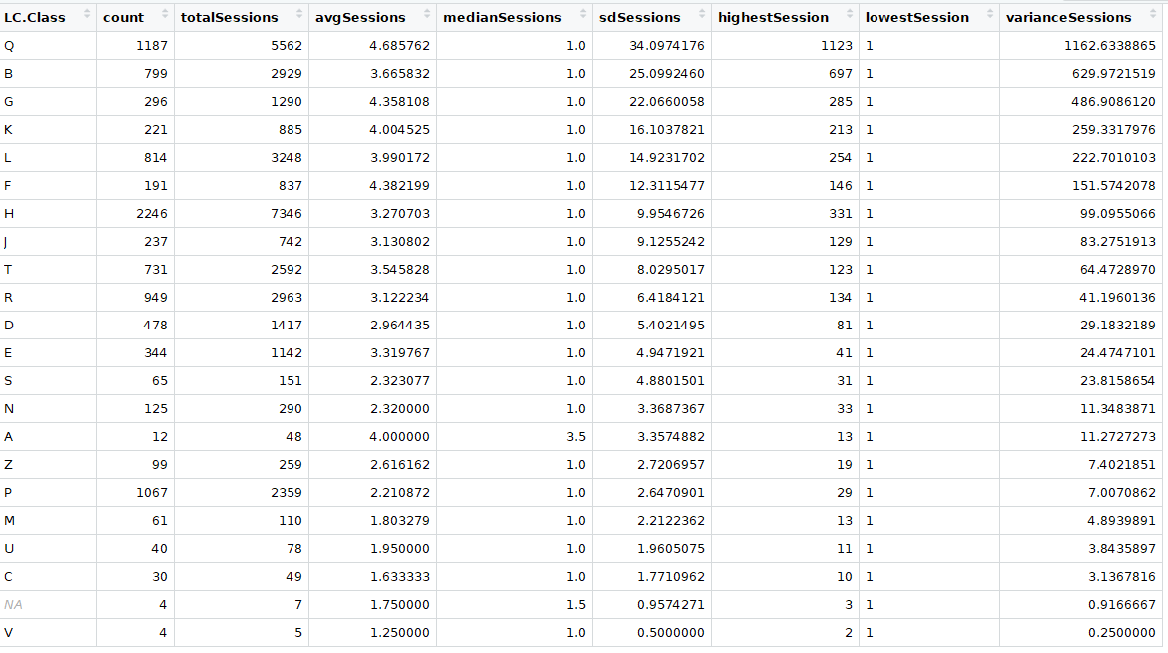

Slide 31
Mind the P and Q
PQSummary <- filter(byLCSummary
, LC.Class == "P" | LC.Class == "Q")
Despite having comparable numbers of items (1187 and 1067), Q has a much higher standard deviation and variance.
Usage of P books is lower and much more evenly distributed.
Q has at least one serious outlier.

Slide 32
Mind the P and Q
T Test
> P <- filter(ebooks, LC.Class == "P")
> Q <- filter(ebooks, LC.Class == "Q")
> t.test(P$User.Sessions, Q$User.Sessions)
Welch Two Sample t-test
data: P$User.Sessions and Q$User.Sessions
t = -2.4923, df = 1201.9, p-value = 0.01282
alternative hypothesis: true difference in means is not equal to 0
95 percent confidence interval:
-4.423088 -0.526694
sample estimates:
mean of x mean of y
2.210872 4.685762

Slide 33
Visualizing data with ggplot2

Slide 34
Visualizing data
Base R includes several functions for quick data visualization
plot()
barplot()
hist()
boxplot()
However, most R users consider ggplot to be the most elegant and versatile

Slide 35

ggplot2
As dplyr implements a “grammar” for data manipulation, ggplot2 does so for data visualization
Also created by Hadley Wickham
As always, start by loading the package
> library(ggplot2)
Portions of this section are adapted from the Data Visualization chapter of R for Data Science: http://r4ds.had.co.nz/data-visualisation.html

Slide 36

ggplot2
Will plot directly to the Plots tab in the Navigation Pane (lower right)
But you also assign it to a variable and call print()
ggplot() creates the initial coordinate system (a “blank canvas”) that you then add layers to
Functions are added with +
> ggplot(data = ebooks)

Slide 37
geoms
Data is visualized in the canvas with geometric shapes, what are called geom functions
ggplot2 contains over 30 geoms. For example,
Bar plots use geom_bar()
Histograms use geom_histogram()
Line plots use geom_line()
Scatter plots use geom_point()

Slide 38
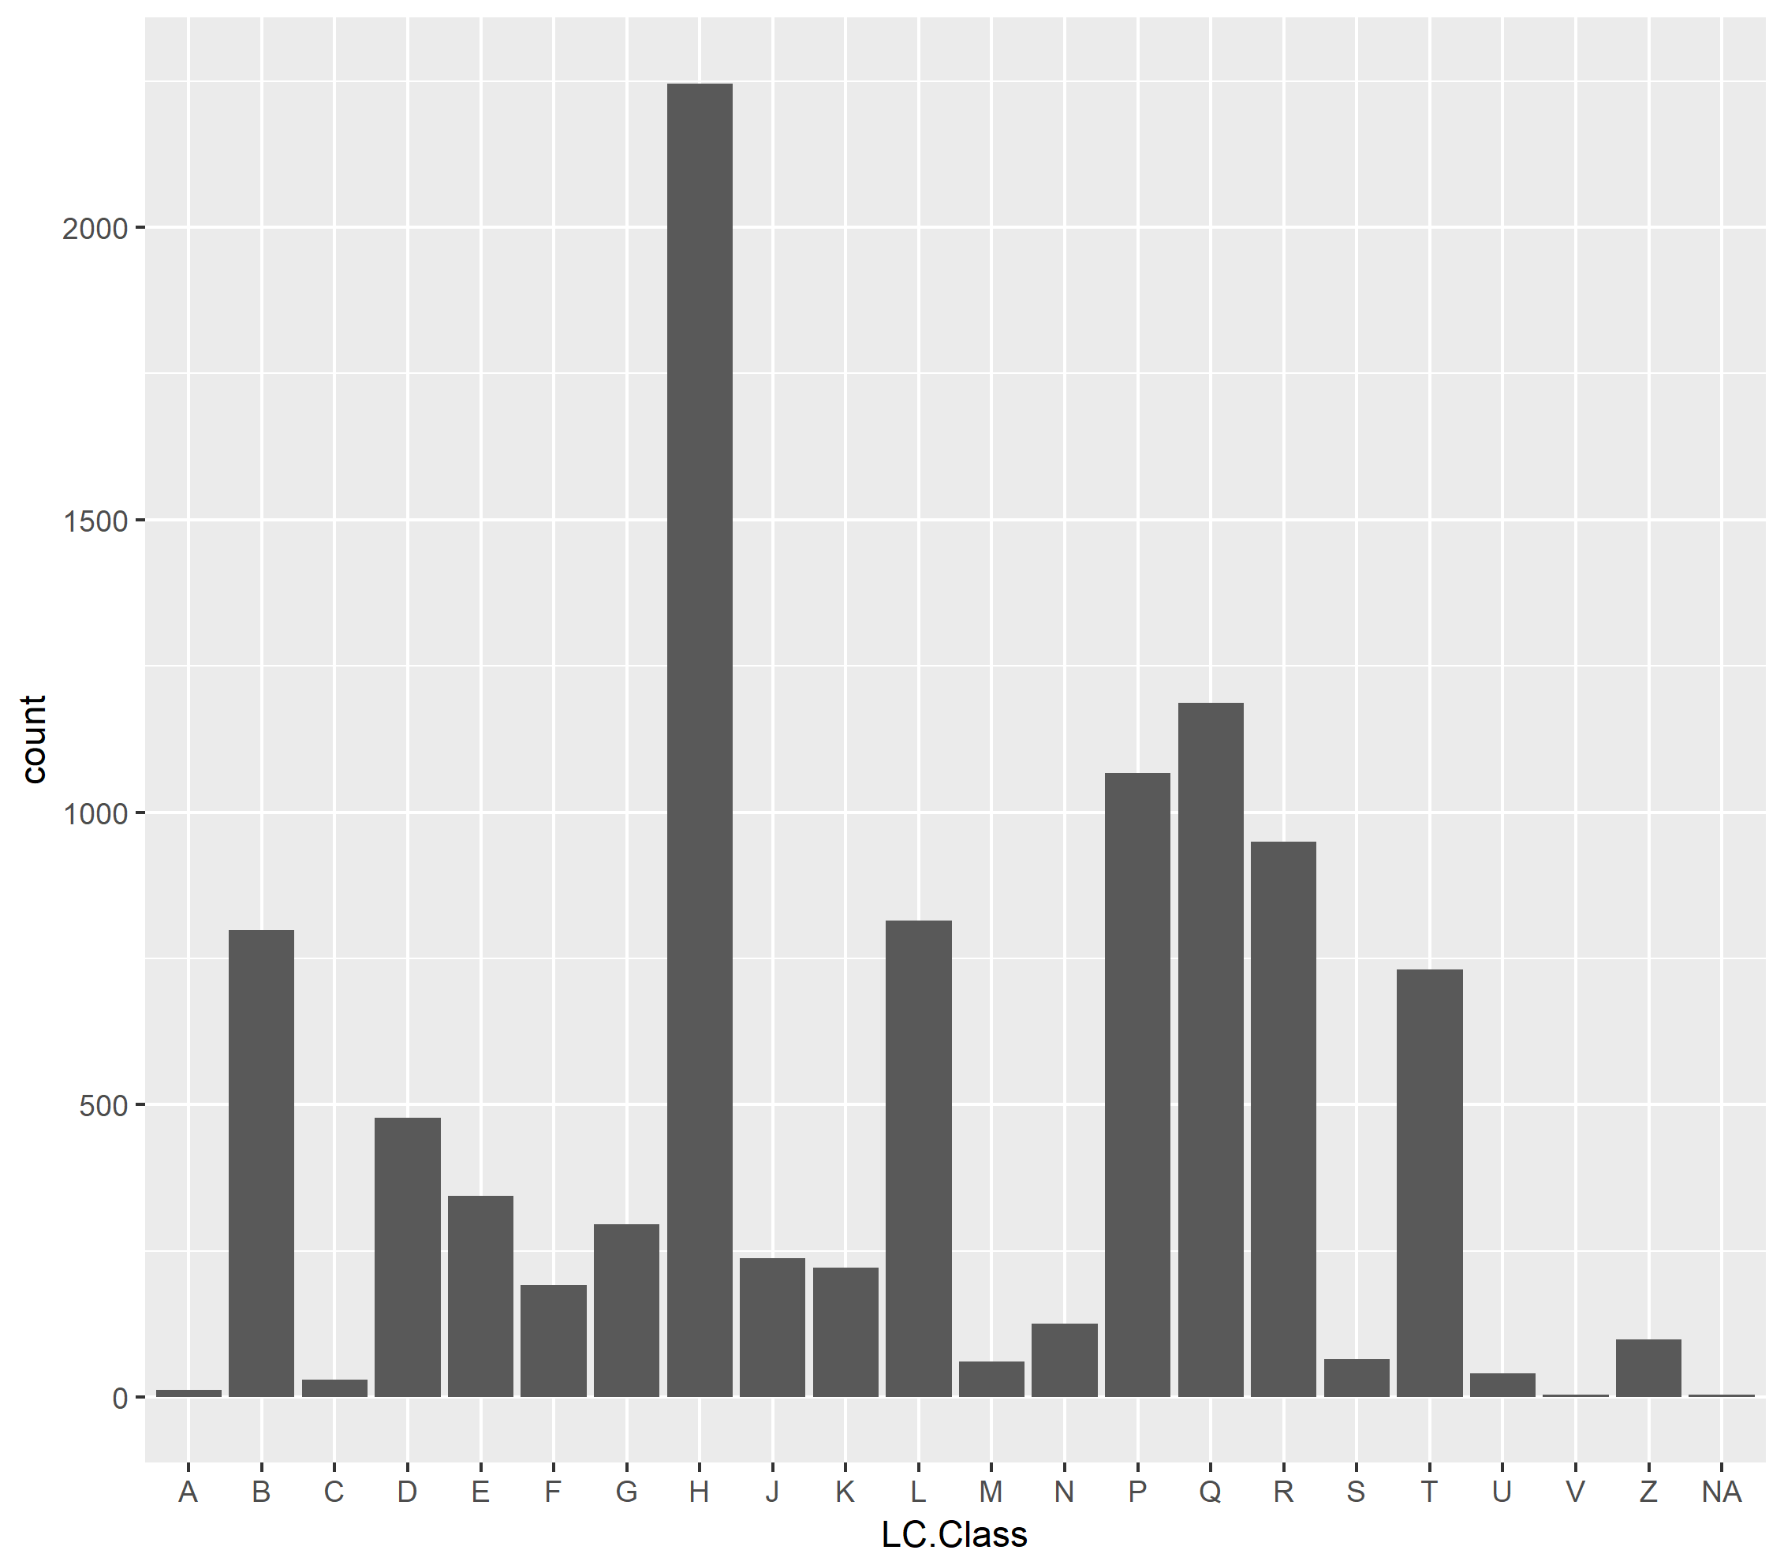
geoms
Add a layer of bars to the plot with geom_bar(). This creates a bar plot:
> ggplot(data = ebooks) +
geom_bar(mapping = aes(x = LC.Class))

Slide 39
aes: Mapping aesthetic
Each geom takes a mapping argument
This is paired with aes(), the aesthetic mapping argument
The x and y arguments to aes specify which variables to map to the x and y axes
ggplot looks for the mapped variable in the data argument

Slide 40
aes: Mapping aesthetic
In this case, the LC.Class is being mapped to the x axis
> ggplot(data = ebooks) +
geom_bar(aes(x = LC.Class))
Note that the count is not a variable in the original dataset.
geom_bar is binning your data and plotting the bin counts: the number of items falling into each gin
You don’t need to specify mapping = and it will henceforth be omitted

Slide 41
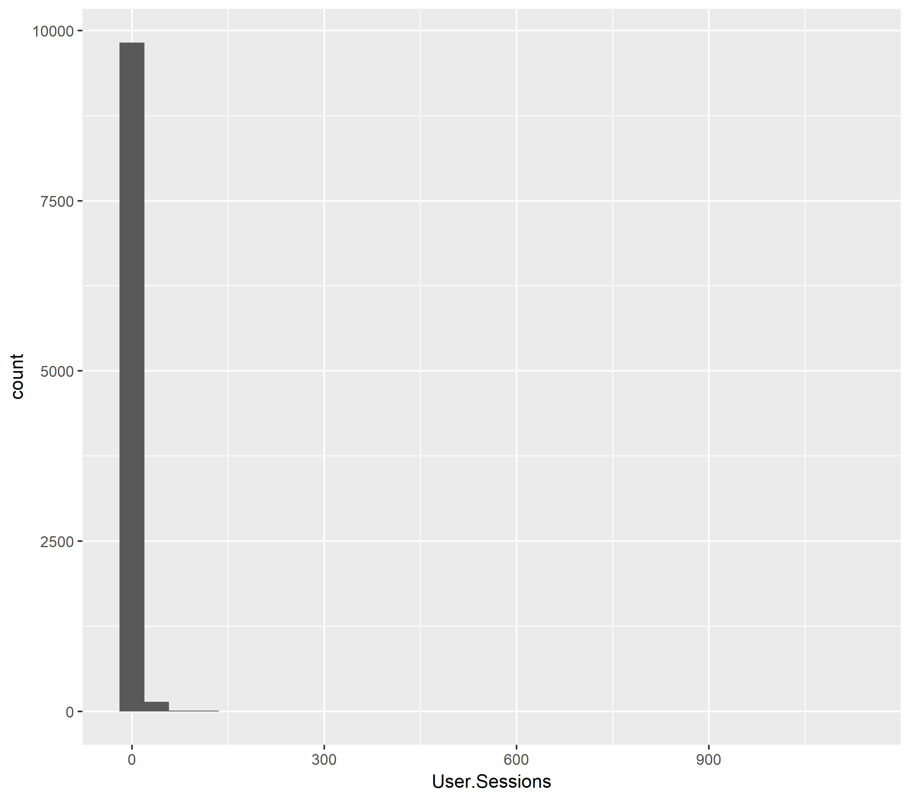
Univariate geoms
Univariate: one variable
> ggplot(data = ebooks
, aes(x = User.Sessions)) +
geom_histogram()
`stat_bin()` using `bins = 30`.
Pick better value with `binwidth`.
Problem: The overwhelming majority of books have a small amount of usage.
This throws off the scale.

Slide 42
Changing scales
I thought about using different data, but this is actually a common problem in usage analysis: The vast majority of items have little to no usage.
Also, this illustrates a way to get around the problem in ggplot: change the x and y scales

Slide 43
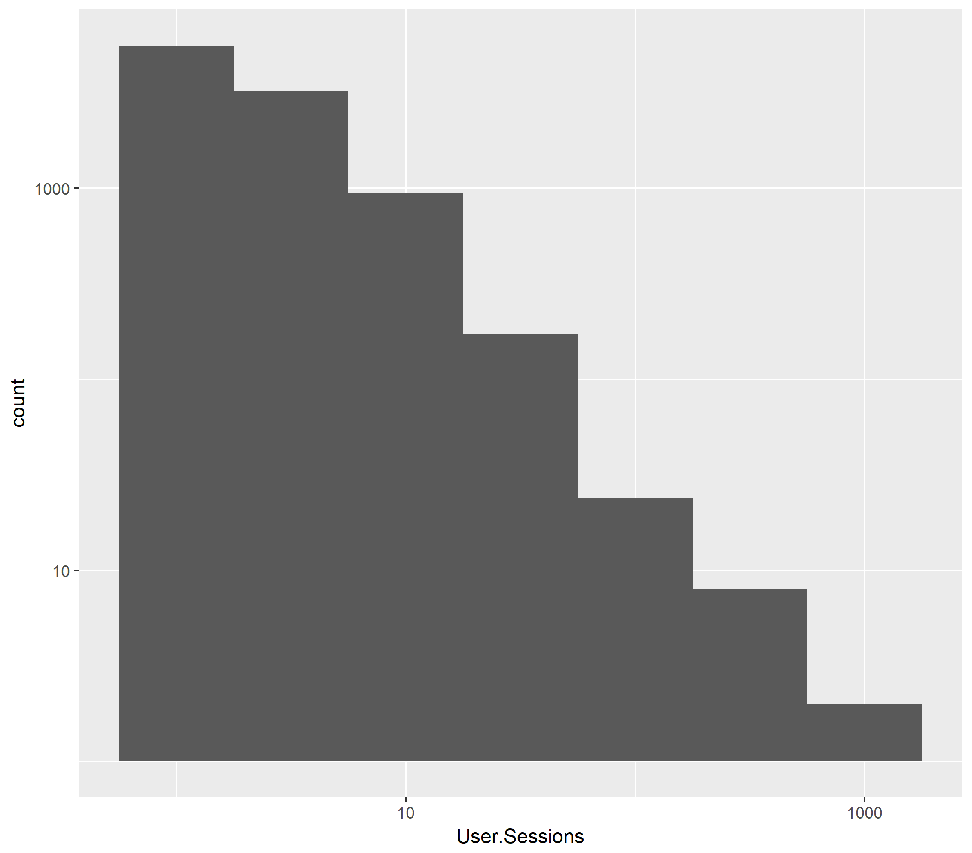
scale_x
> ggplot(data = ebooks) +
geom_histogram(aes(x = User.Sessions)
, binwidth = .5) +
scale_x_log10() +
scale_y_log10()
Notice the scale goes from 10 to 100 to 1,000.
So over 1,000 ebooks have 1-5 user sessions,
And a very small number have over 1,000 user sessions

Slide 44
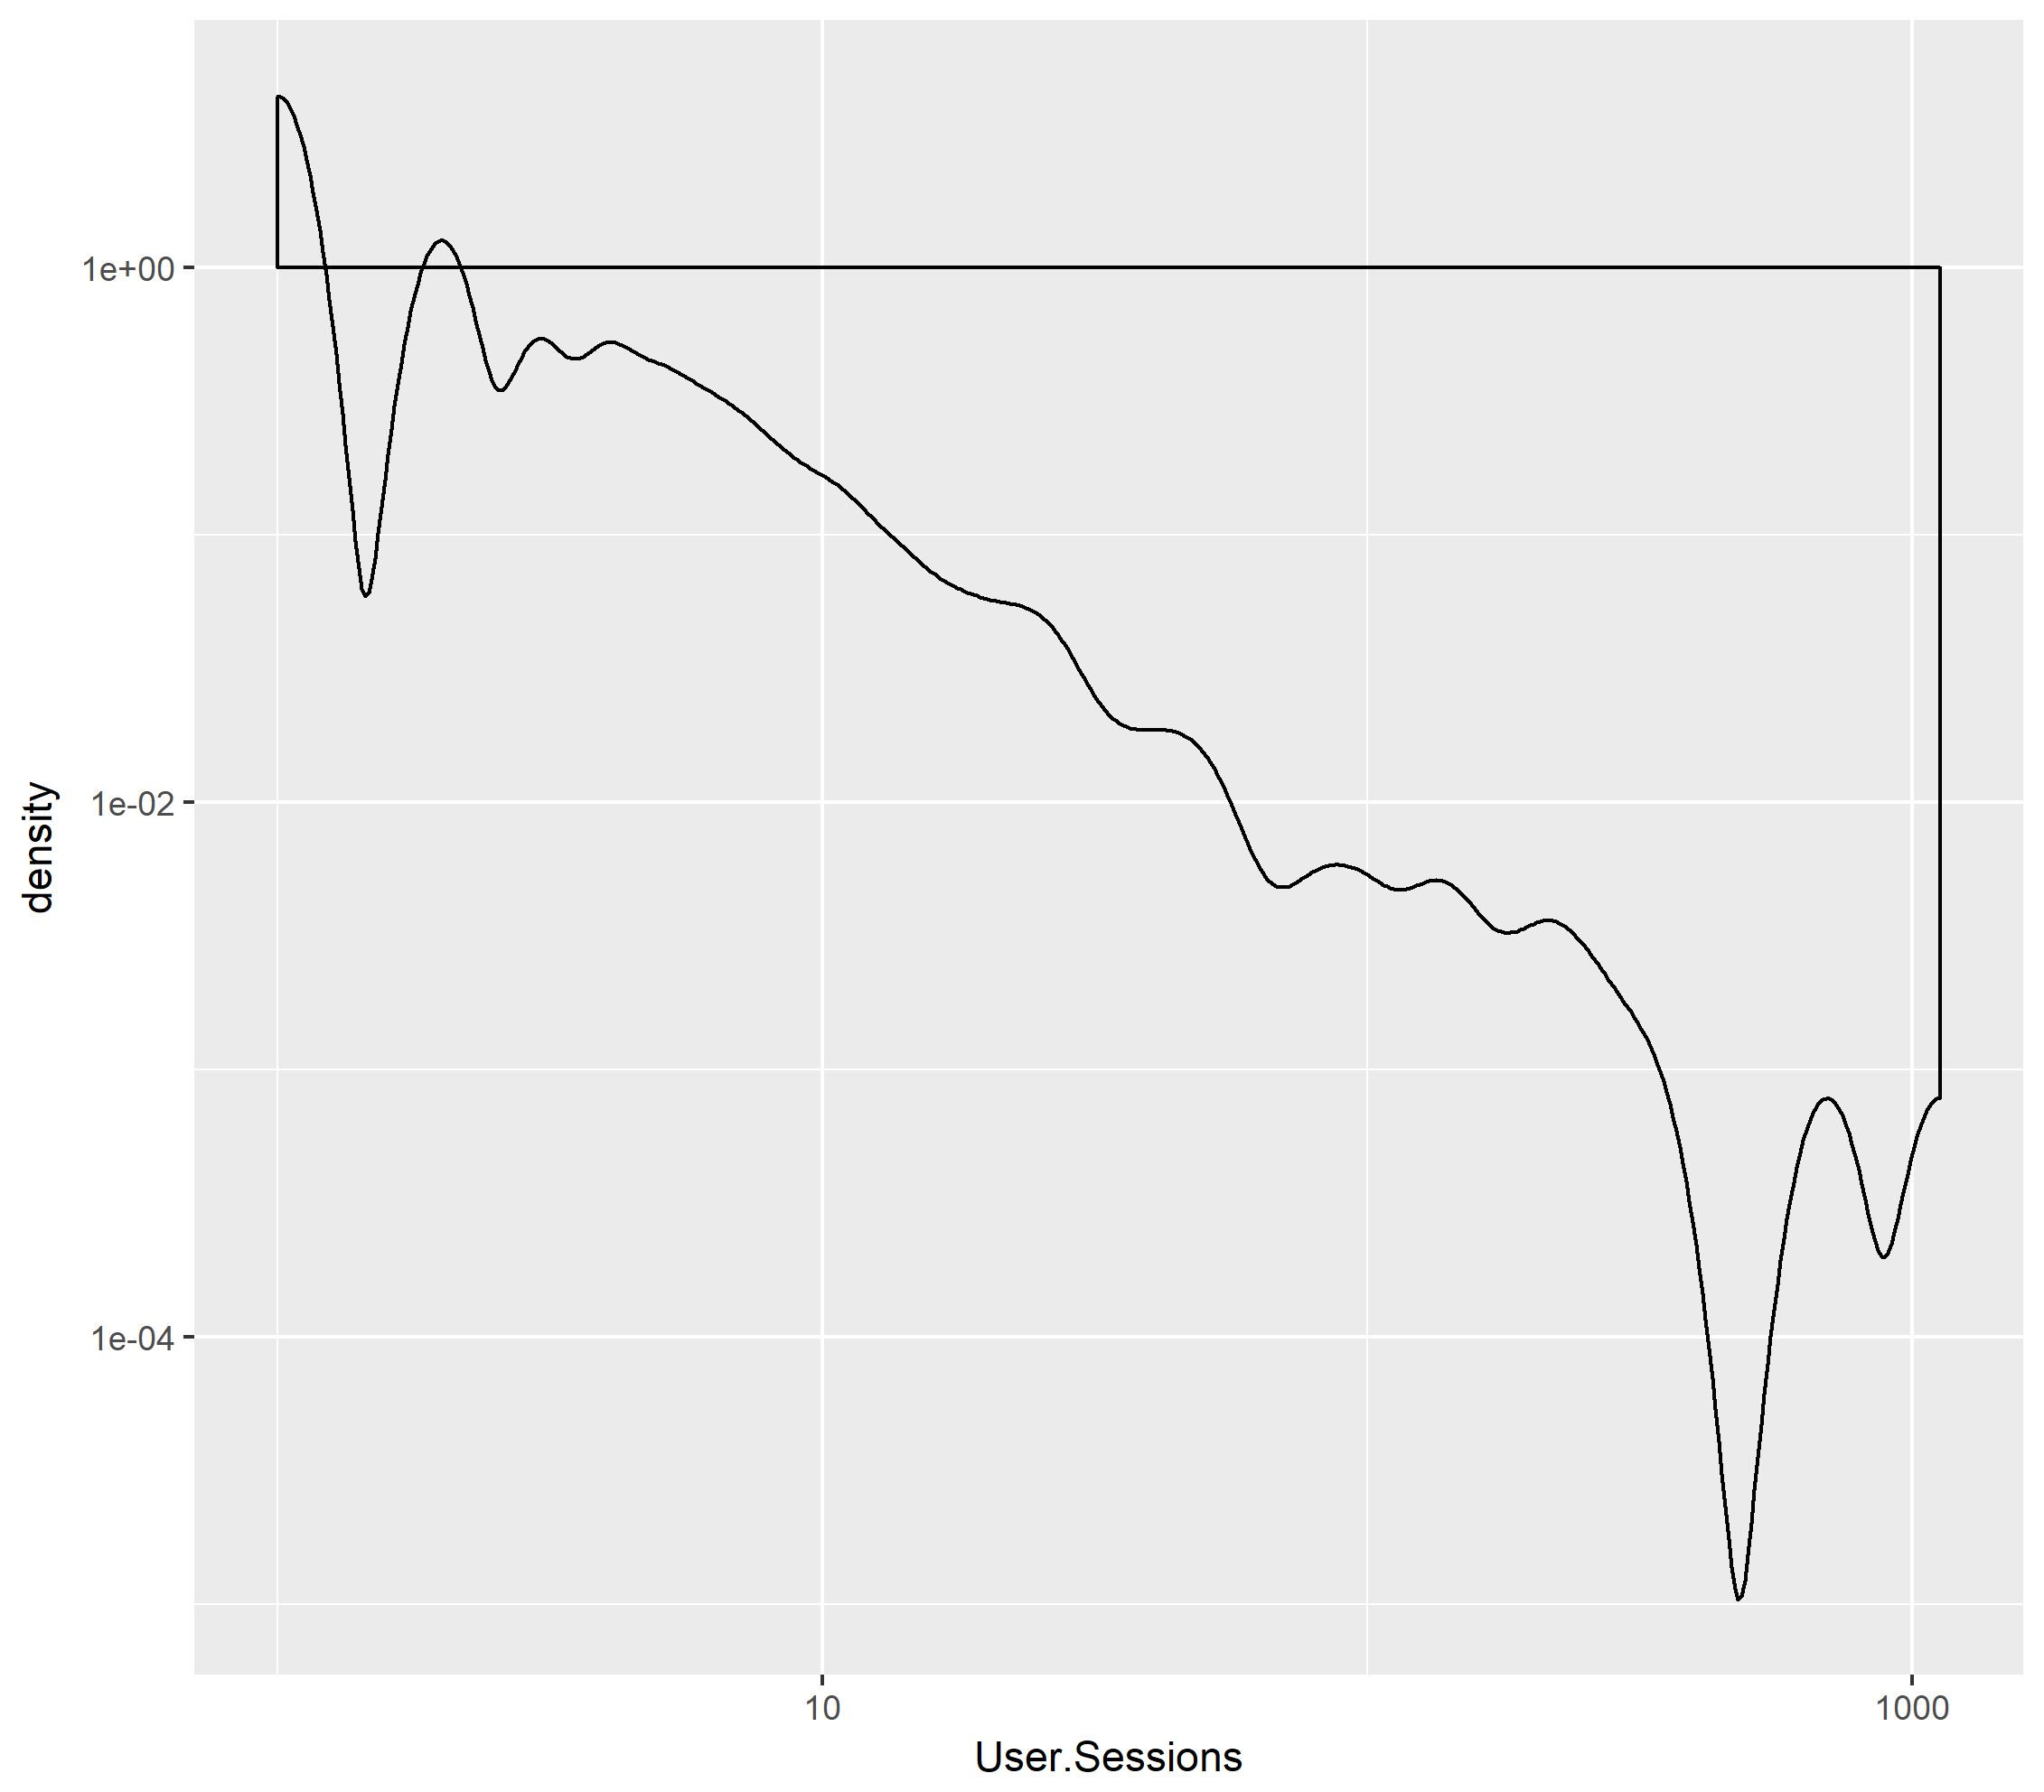
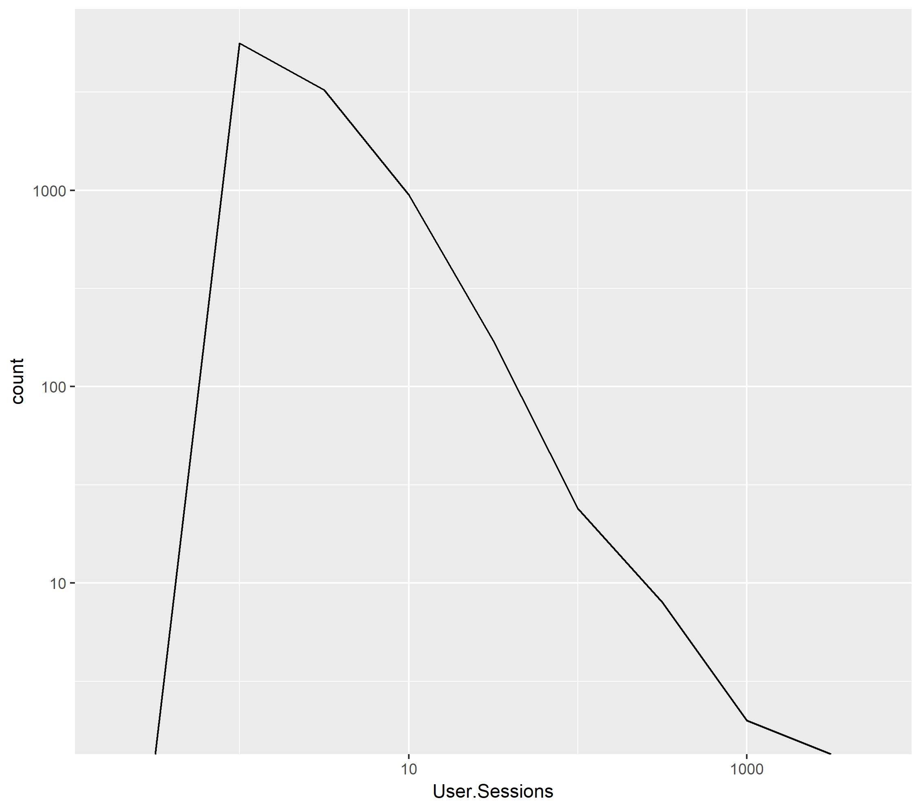
geom_freqpoly()
geom_density()
> ggplot(data = ebooks) +
geom_histogram(aes(x = User.Sessions)
, binwidth = .5) +
scale_x_log10() +
scale_y_log10()

Slide 45
Bivariate geoms
Bivariate: multiple variables
Let’s take a look at some higher usage items.
First, create a filtered data set with extreme outliers removed:
> ebooksPlot <- filter(ebooks
, User.Sessions < 500 & User.Sessions > 10)

Slide 46
Bivariate geoms
Plot user sessions by call number class.
Still using a logarithmic scale
> ggplot(data = ebooksPlot) +
geom_point(aes(x = LC.Class, y = User.Sessions)) +
scale_y_log10()

Slide 47
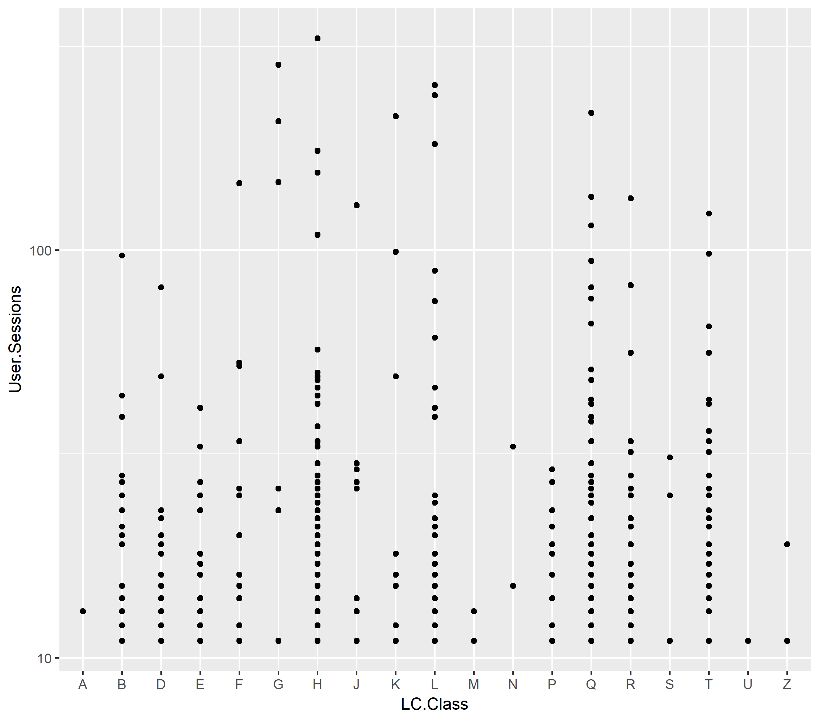
Bivariate
Again, notice the scale.
A few quick observations:
P has no items with over 10 user sessions
G has very few items, but 3 of them have over 100 sessions

Slide 48
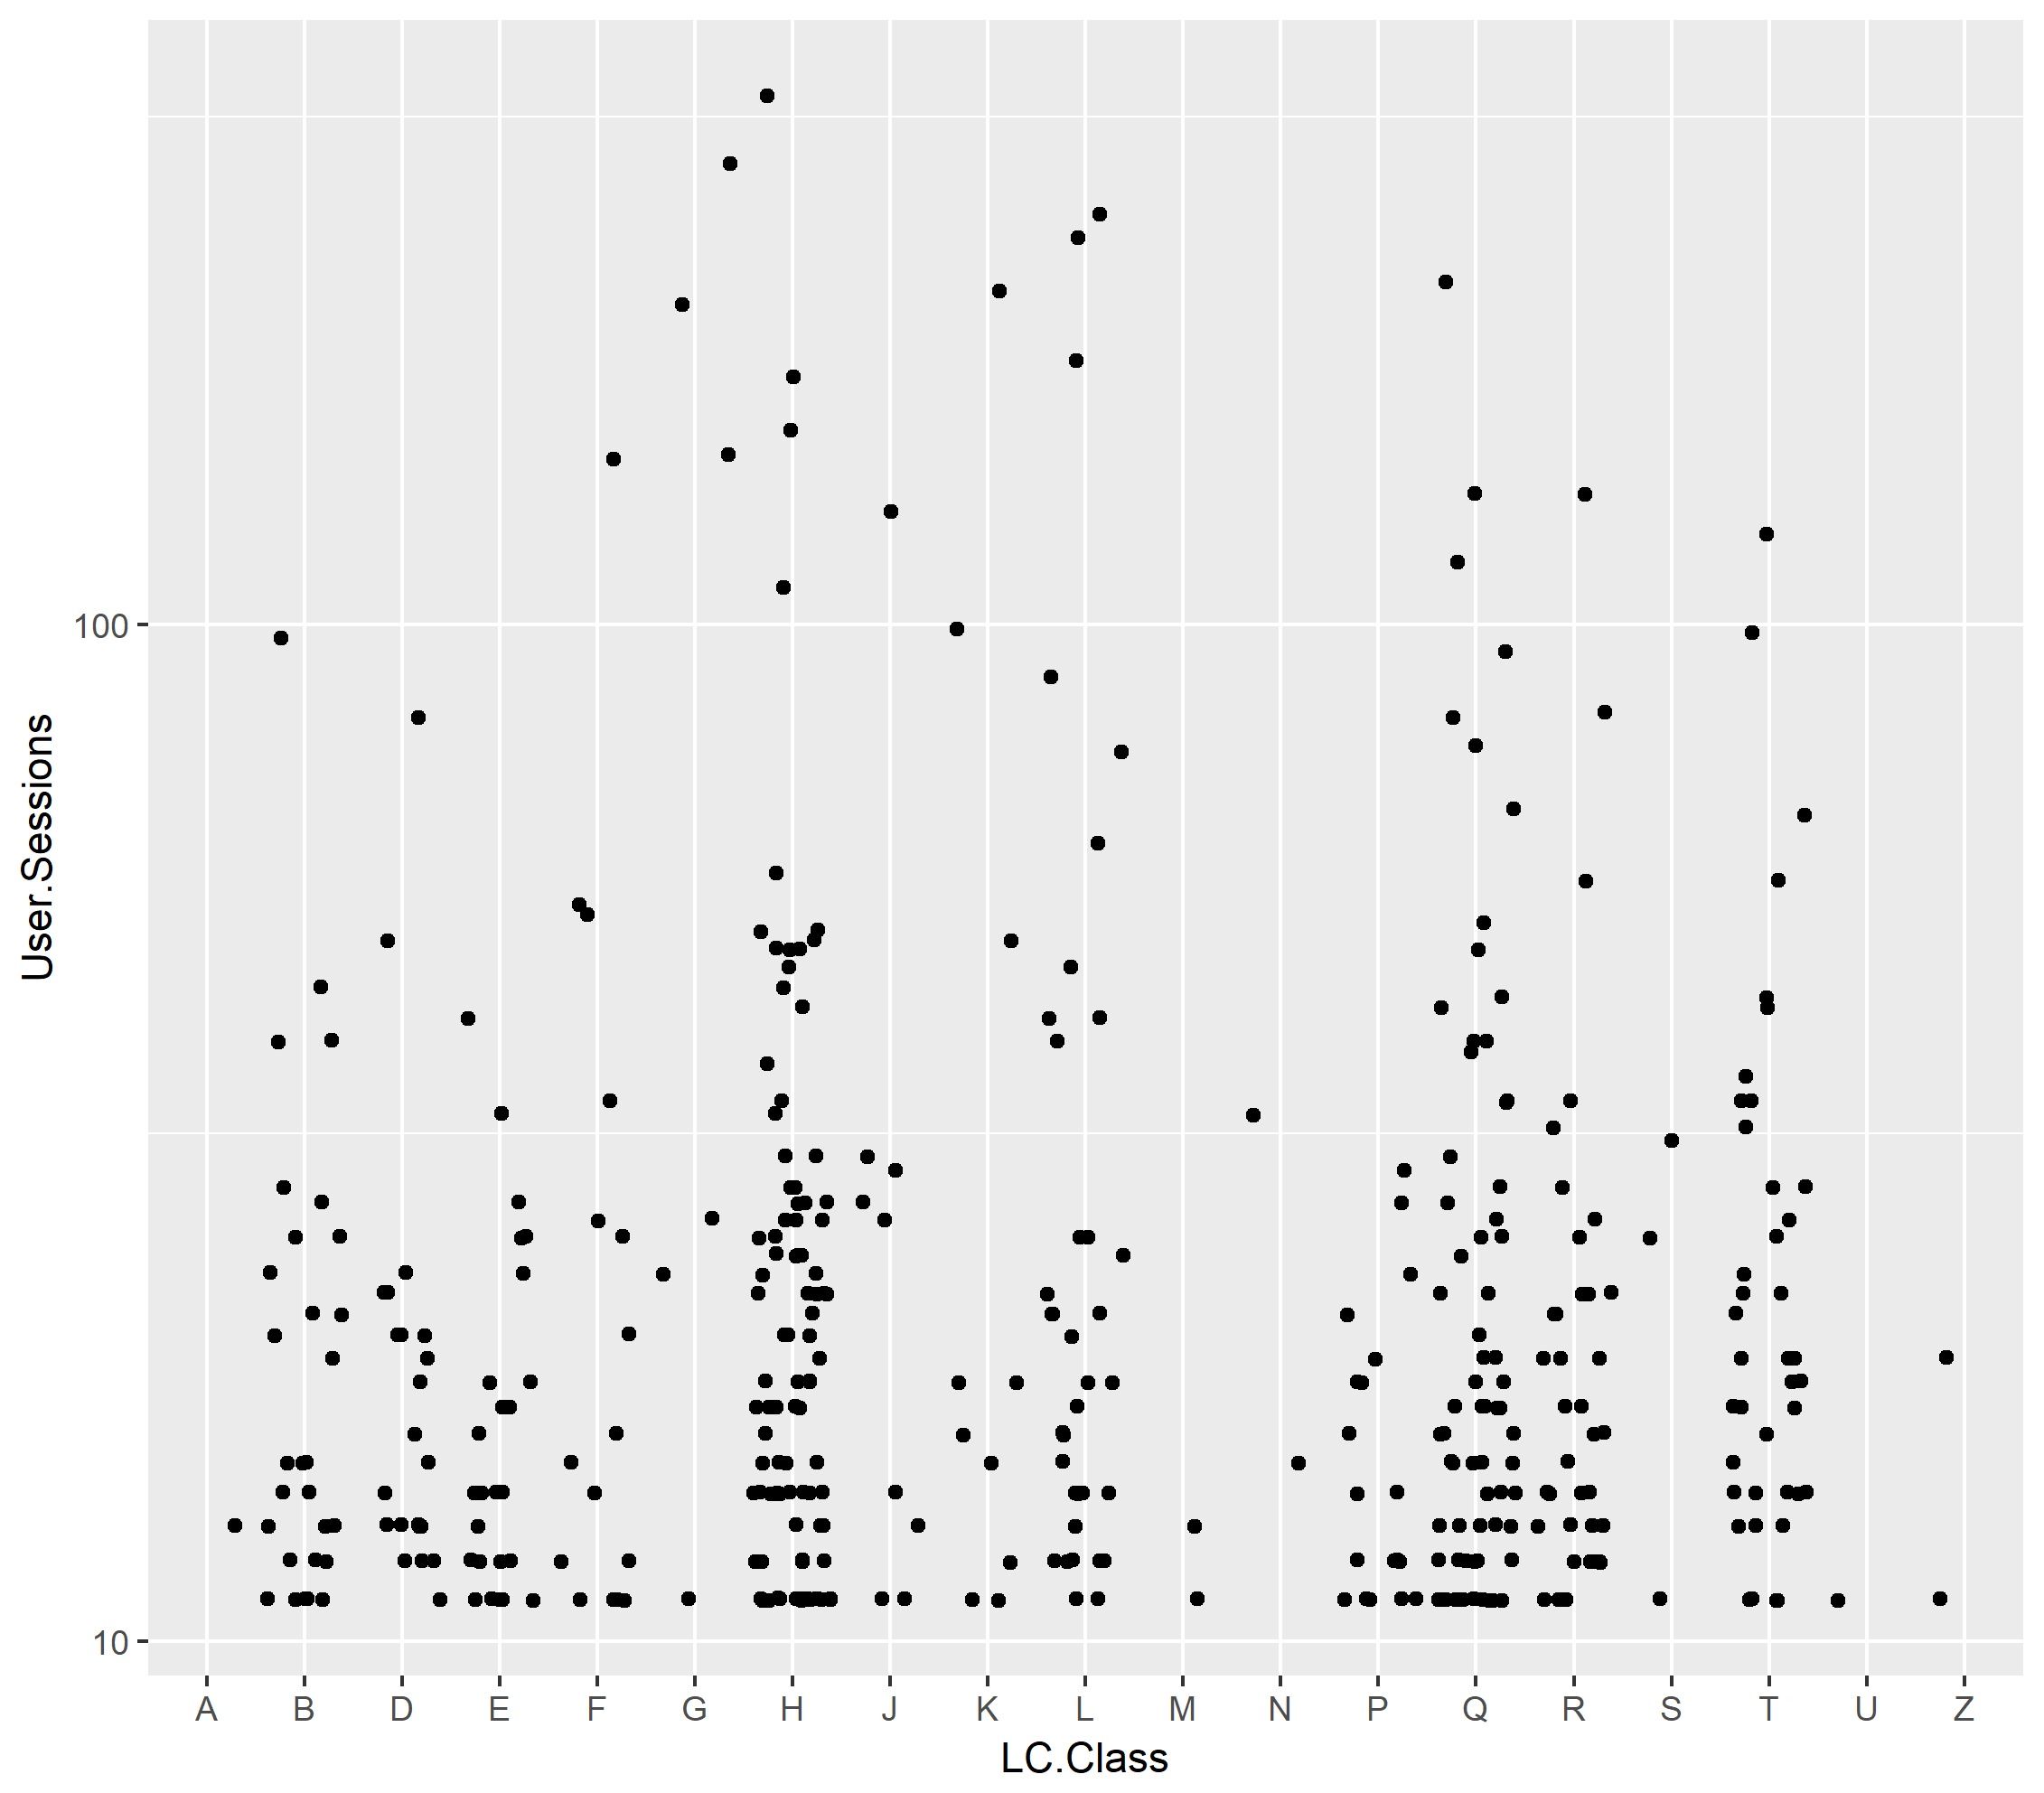
Bivariate
geom_jitter()
Same as geom_point but adds a bit of vertical space between dots

Slide 49
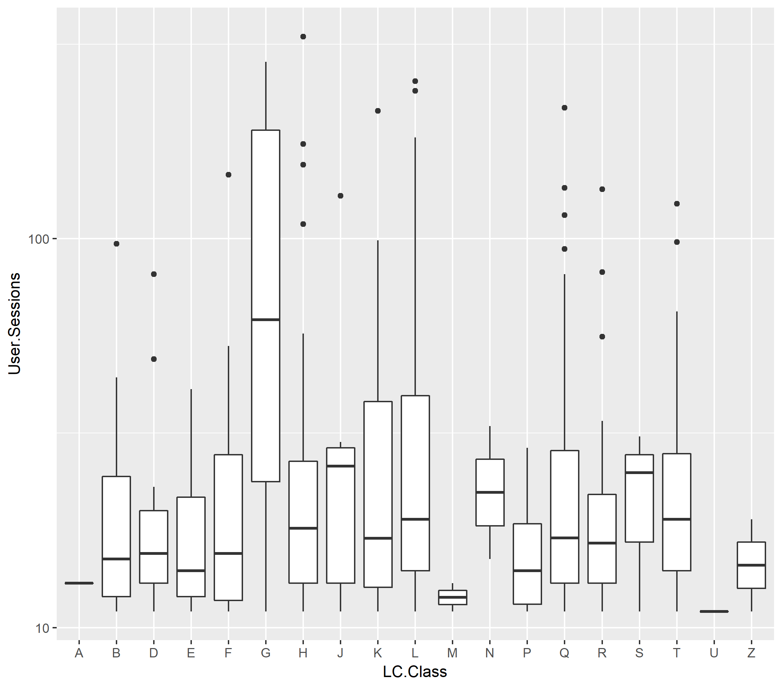
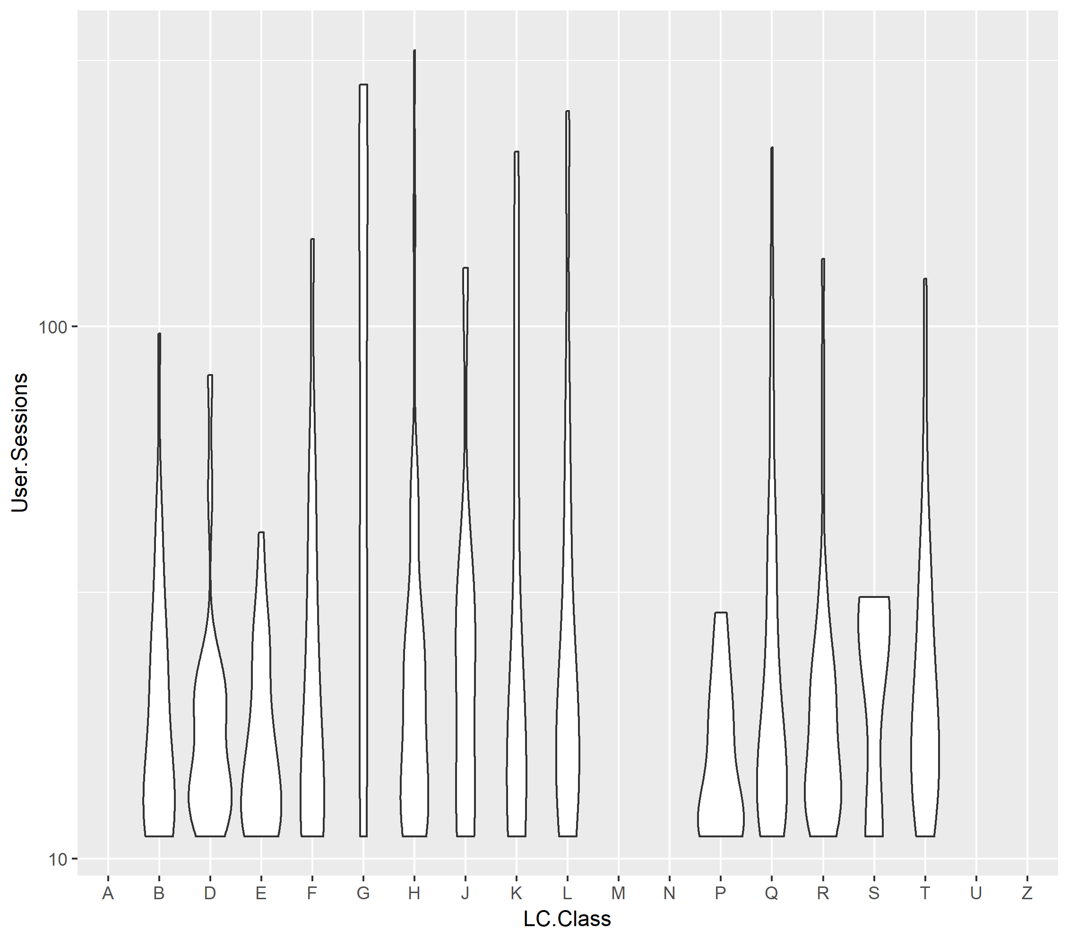
geom_boxplot()
geom_violin()
> ggplot(data = ebooksPlot) +
geom_point(aes(x = LC.Class, y = User.Sessions)) +
scale_y_log10()

Slide 50
Add a third variable with aes()
We previously mapped variables to the x and y axes using aes().
We will now map a third variable to a visual aesthetic, color
> ggplot(data = ebooksPlot) +
geom_point(aes(x = LC.Class
, y = User.Sessions
, color = Collection)) +
scale_y_log10()
Associate the name of the aesthetic (color) to the name of the variable (Collection) inside aes()

Slide 51
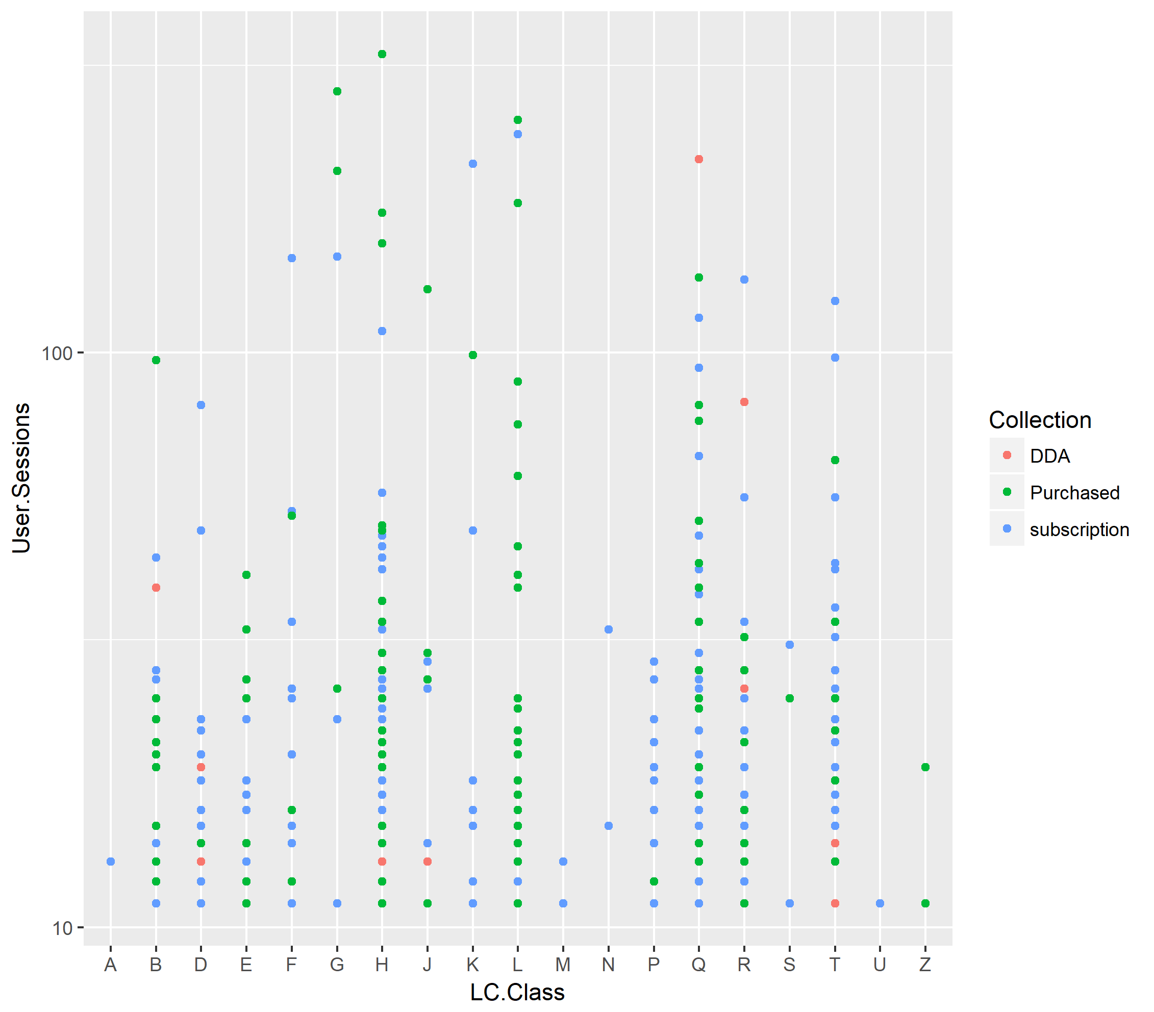
aes(color)
ggplot automatically assigns a unique level of the aesthetic to each unique value of the variable (this is called scaling)
We can see that most high usage titles are subscription or librarian-purchased rather than DDA

Slide 52
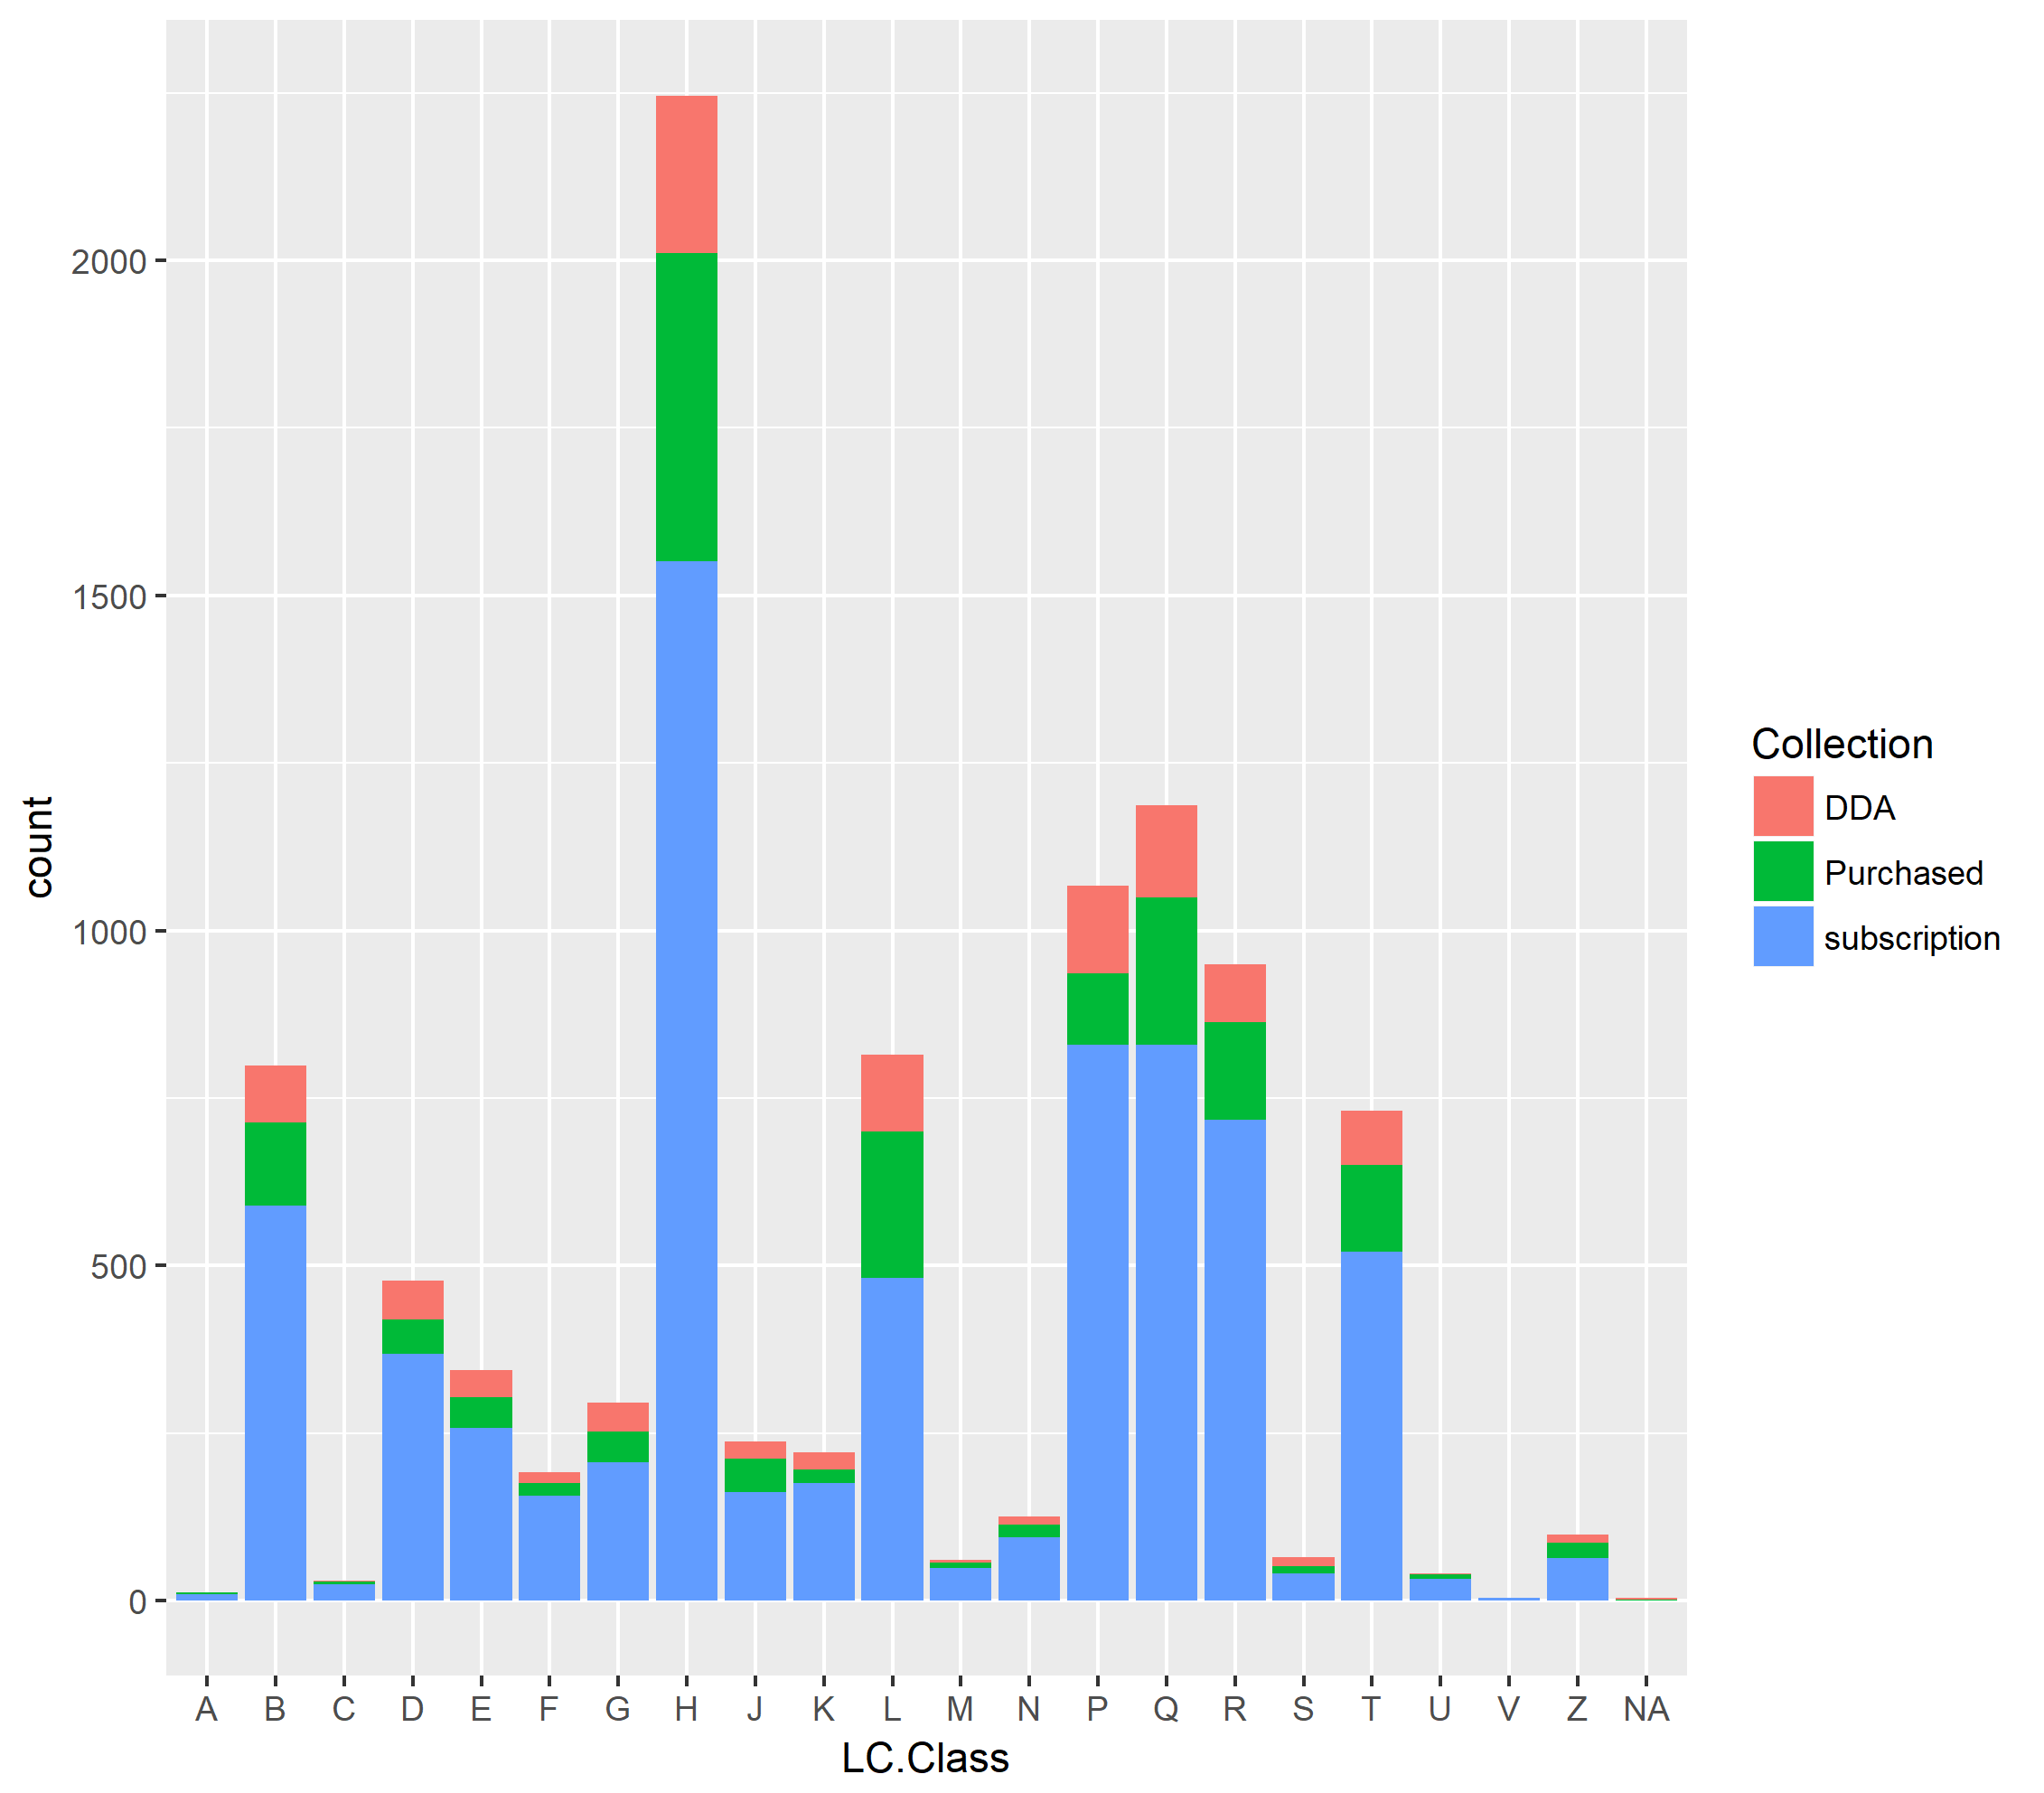
aes(fill)
Use fill with geom_bar to create a stacked bar plot
> ggplot(data = ebooks) +
geom_bar(aes(x = LC.Class
, fill = Collection))

Slide 53
Add a third variable with facets
The facet functions create subplots of subsets of the data
> ggplot(data = ebooksPlot) +
geom_point(aes(x = User.Sessions
, y = Pages.Viewed)) +
facet_wrap(~ LC.Class) +
geom_smooth(aes(x = User.Sessions
, y = Pages.Viewed)) +
scale_x_log10()

Slide 54
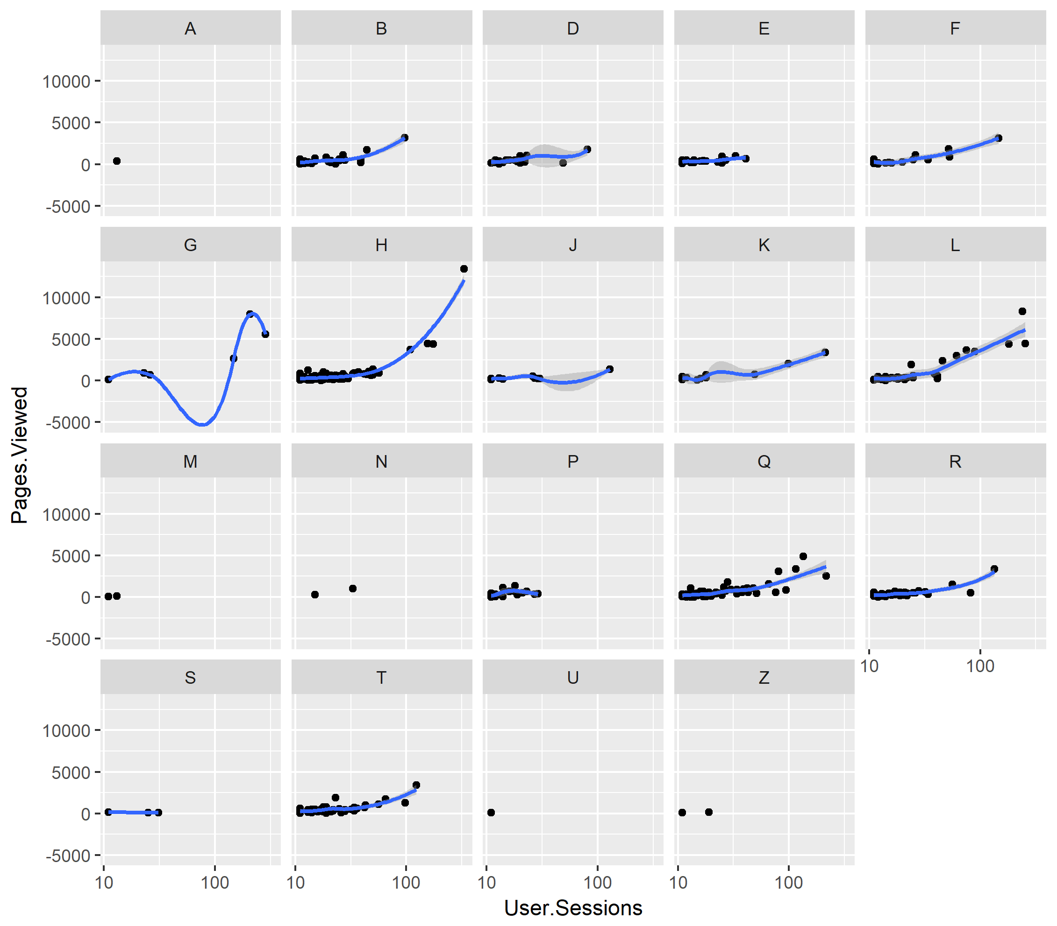

Slide 55
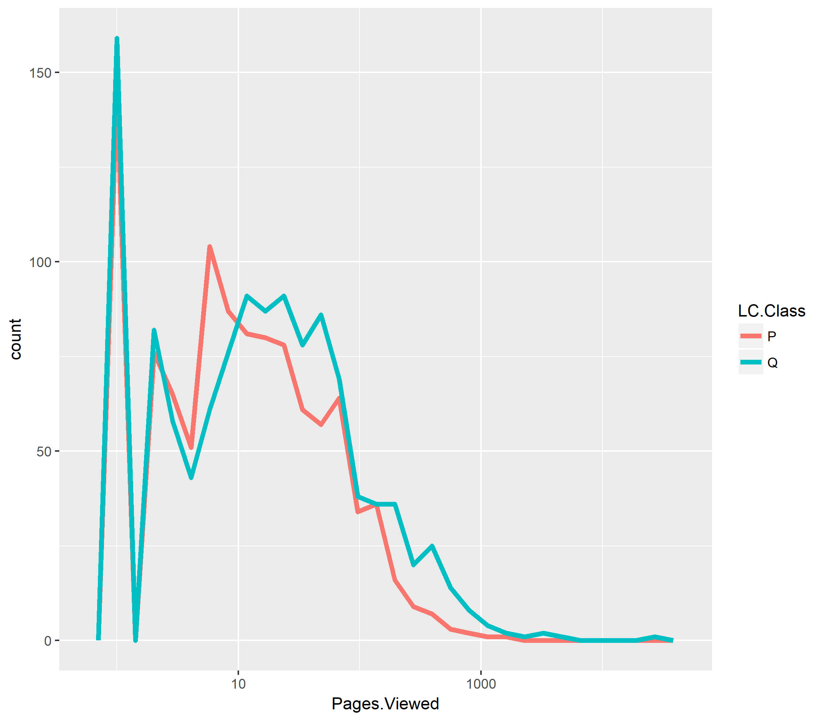
Use with %>%
> filter(ebooks
, LC.Class == "Q" | LC.Class == "P") %>%
ggplot() +
geom_freqpoly(aes(x = Pages.Viewed
, color = LC.Class
, binwidth = .5)
, size = 1.5) +
scale_x_log10()

Slide 56
Style the plot with theme()
You have almost total control over the appearance of your plot.
There are a number of preconstructed themes, which you can view at the tidyverse ggtheme page: http://ggplot2.tidyverse.org/reference/ggtheme.html
You can call help(theme) to view the multiple parameters to add to the theme call to construct your own custom theme.

Slide 57
Save the plot with ggsave()
Call help(ggsave) to read the various arguments you can pass to save your plot, include the filename, path, size, file type (`device`), dimensions, and dpi
> ggsave(filename = “myPlot.png"
, plot = myPlot
, path = "./doc/images/"
, device = "png"
, height = 4
, width = 4
, units = "in")

Slide 58
R Studio shortcuts to know
Windows/Mac key
Run current line/selection in script pane: Ctrl/Cmd + Enter
Skip words (works in Word too) : Ctrl/option + ← or →
Scan through previously entered commands: ↑ or ↓
Insert <- : Alt/Option + -
Jump from Console to Script pane: Ctrl + 1
Jump from Script pane to Console: Ctrl + 2
Fix indentation in script pane: Highlight text and press Ctrl + i
Rerun previous chunk of code: Ctrl/Cmd + Shift + P
See all on the R Studio Cheat Sheet: https://www.rstudio.com/wp-content/uploads/2016/01/rstudio-IDE-cheatsheet.pdf

Slide 59

Victory!
Continue working through the handouts and help pages.
If there is enough continuing interest, perhaps we can form an R (support) Group

Slide 60
Questions?

